Slide 1
Neural Nets IV
Including Deep Learning

Slide 2
Learning Objectives
Leverage NN architectural options
convolution
pooling
softmax
autoencoders
Exploit convergence options
Stochastic gradient descent
Adam

Slide 3
Learning and Intro to Neural Nets
Softmax in Output
Optimizers 2/2
Deep Learning
Convolution, Pooling, and Auto-encoding
Summary and Conclusion

Slide 4
Dealing with Output
Single continuous output node
(“regression”)
Multiple output nodes—usually for comparison
Problem: differing scale e.g., 229, 0.03, 99, -1000
Solution: softmax function is output shown.
Each between 0 & 1; all sum to 1
e.g., replace 229 by e²²⁹ / [e²²⁹ + e^{0.03} + e⁹⁹ + e⁻¹⁰⁰⁰]
Notes:
When the output to a neural net is a single continuously varying node value, this is often referred to as regression.
When the output consists of multiple nodes, the problem is usually one of classification, such as distinguishing hand drawings of digits 1, 2, 3, and 4. Without some sort of normalization, these can be hard to distinguish—for example, output of 229, 0.03, 99, and -1000.
This is often dealt with using the softmax process, which replaces the outputs {o1, o2, …, on} with
{e^{o1}/[e^{o1} + e^{o2} + … +e^{on}], e^{o2}/[e^{o1} + e^{o2} + … +e^{on}], …, e^{on}/[e^{o1} + e^{o2} + … +e^{on}]}
The advantage of this is that the amount are between 0 and 1, and they sum to 1.

Slide 5
Softmax Example
Given raw output: -2, 3, and 8,
Softmax is:
0.000047,
0.006694, and
0.993259
Notes:
Softmax retains relative magnitudes while placing the values in a comparable framework. Its use is actualy a departure from normal neural net forms in that the computation at a node depends on the values of peers (i.e., not just predecessors). However, this is usually not a problem when applied only to output nodes.

Slide 6
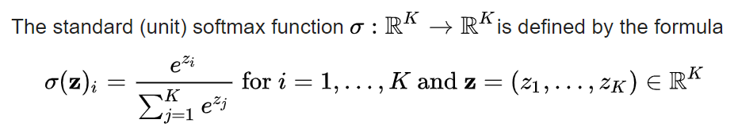
Softmax Formula
https://en.wikipedia.org/wiki/Softmax_function

Slide 7
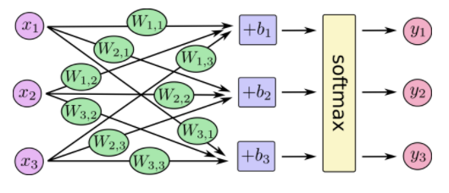
Softmax Diagramming
784
x‘s
10 output
nodes
https://www.tensorflow.org/get_started/mnist/beginners
Notes:
The figure shows one way to depict softmax.

Slide 8
Softmax Usage in TensorFlow
W1 = tf.Variable(tf.zeros([784, 10])) b = tf.Variable(tf.zeros([10])) … define model, compile, train …
softmax
784
10
W1
x
https://www.tensorflow.org/tutorials/keras/classification
Notes:
The TensorFlow softmax function operates on a rank 1 tensor.

Slide 9
Softmax Usage in TensorFlow
W1 = tf.Variable(tf.zeros([784, 10])) b = tf.Variable(tf.zeros([10])) … define model, compile, train … probability_model = tf.keras.Sequential\ ([model, tf.keras.layers.Softmax()]) predictions = probability_model.predict(test_images)
softmax
784
10
W1
x
https://www.tensorflow.org/tutorials/keras/classification
Notes:
TensorFlow has a built-in softmax function that you typically use at testing and execution time.

Slide 10
Learning and Intro to Neural Nets
Softmax in Output
Optimizers 2/1
Deep Learning
Convolution, Pooling, and Auto-encoding
Summary and Conclusion

Slide 11
Batch Gradient Descent (One Extreme: w.r.t. All Weights)
Errors for all training pairs added:
e = ∑ e_{p} / n _{n = # pairs}
over all training pairs p
Relative to each w_{ij}, derivative:
∂e/ ∂w_{ij} = [∑ ∂e_{p}/ ∂wij ] / n
Notes:
In batch gradient descent (BGD), the errors for all training pairs are summed. It is this sum that we want close to zero. Its rate of change is the sum of the derivatives, which we obtained in the last section.

Slide 12
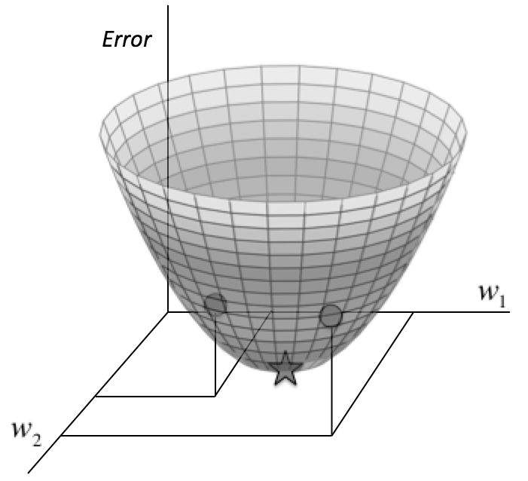
Batch Gradient Descent
From “Fundamentals of Deep Learning: Designing Next-Generation Machine Intelligence Algorithms” by Nikhil Buduma Buduma p19
Notes:
The figure visualizes Loss as a function of two weights. In this simple example, there is a clear loss (error) zero for a particular weight combination (the star). The issue is how to get there.

Slide 13
Projection onto plane
tangent
plane
Notes:
The two derivatives can be thought of as two orthogonal arrows in the tangent plane.

Slide 14
Proportional Change for Gradient Descent
-0.2 feet per horizontal foot
-0.3 feet per horizontal foot
Notes:
The objective is to determine what direction to step with the steepest decline. The determination is local to the point you are at, so you might as well assume that the surface you are on is a plane. Assume that the plane slopes downward somewhat in both directions. You can visualize this by drawing two lines at right angles on cardboard and sloping it down a bit. Neither of the two directions necessarily has the greatest slope.

Slide 15
Pure Gradient Descent
-0.2 feet per horizontal foot
-0.3 feet per horizontal foot
Notes:
Continuing the cardboard analogy, you may be able to see, by holding a piece of cardboard with two arrows drawn on at right angles, that the steepest direction is that of the dashed line—the hypotenuse. In other words, proceeding in the ratio -0.3 : -0.2 (3:2) for first weight / second weight. (You can actually see this immediately when one of these numbers is 0.)
To recap, the process of adjusting the weights (in proportion) where the Loss is the sum of all training pair Losss is called batch gradient descent.

Slide 16
Local Minima
It was commonly thought that simple gradient descent would get trapped in poor local minima — weight configurations for which no small change would reduce the average error.
In practice, poor local minima are rarely a problem with large networks. Regardless of the initial conditions, the system nearly always reaches solutions of very similar quality. Recent theoretical and empirical results strongly suggest that local minima are not a serious issue in general. Instead, …
“Deep Learning” by Yann LeCun, Yoshua Bengio, & Geoffrey Hinton doi:10.1038/nature14539

Slide 17
Saddle Points
Instead, … the landscape is packed with a combinatorially large number of saddle points where the gradient is zero, and the surface curves up in most dimensions and curves down in the remainder.
The analysis seems to show that saddle points with only a few downward curving directions are present in very large numbers, but almost all of them have very similar values of the objective function. Hence, it does not much matter which of these saddle points the algorithm gets stuck at.

Slide 18
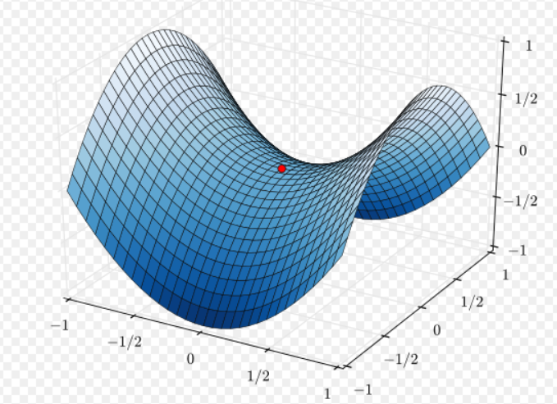
Problem with Batch GD
Following a hill downward often leads to saddle points.
https://en.wikipedia.org/wiki/Saddle_point#/media/File:Saddle_point.svg
Notes:
Going downhill from a point towards zero derivative looks promising but there are two problems.
The first is that one may hit a local minimum. In other words, a value for (w₁, w₂) where the derivatives are zero—locally minimal—but where values for (w₁, w₂) exist with a lower (perhaps much lower) error. Now, the error is supposed to be zero or very close, so this would occur when the process converges on a error not close to zero (“stuck in a local min”) or an error that is small but which leaves open the possibility of a smaller error.
The other possibility is that the derivatives are zero—or very close—due to a saddle point, as shown in the figure. In fact, when there are 4 weights (for example) and zero derivative relative to each one, then only 1 out of 16 combinations is a minimum in every principal direction. The rest are saddle points! In short, an all-zero-derivative point is most likely to be a saddle point rather than a minimum.

Slide 19
Problem is Potentially Severe ..
The weight (“parameter”) space is hundreds-dimensional so saddle points are likely.
Notes:
It is impossible to visualize 100-dimensional space but one expects (hopes?) that intuition from 2-D carries over.

Slide 20
The Other Extreme: Stochastic Gradient Descent w.r.t. One Weight
e
Functions of a single variable
much easier to handle
w_{ij}
Notes:
Stochastic Gradient Descent (SGD) computes the gradient for a single weight, adjusts the weight, and then repeats for the next weight. This is theoretically slower than BGD but allows more flexibility in finding minima. In practice, it is easier to avoid saddle points.

Slide 21
Compromise: Minibatch Gradient Descent
Proceed by subsets of the weights--perhaps default.
In TensorFlow: Controlled by batch_size parameter
typically 10-1000; TF allows dynamic
model.fit(x, y, batch_size=32, epochs=10)
https://www.tensorflow.org/tutorials/eager/custom_training_walkthrough
Notes:
A technique that avoids the opaqueness of BGD and the slowness of SGD is minibatch gradient descent. It is so commonly used that it is often called “stochastic gradient descent.”
It is hard to speak in general terms about all neural nets but a number of theoretical results suggest that local minima often occur remarkably close to absolute minima, and that the finding the latter is not as much of a problem as may be feared.

Slide 22
Other Approaches
Momentum slows the pace at which learning takes place
Second order gradients (second derivatives) can detect saddle points
But add complication
Not supported in TF(?)
Notes:
“Momentum” in physics is mass × velocity; these are translated conceptually to parameters in learning.

Slide 23
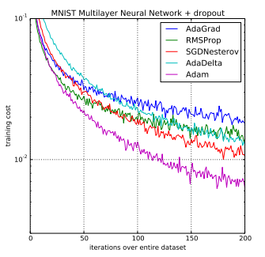
The Adam Optimizer
Adam: A Method for Stochastic Optimization by Diederik P. Kingma, Jimmy Ba https://arxiv.org/abs/1412.6980 (2017) (as adapted)
An algorithm for first-order gradient-based optimization of stochastic objective functions
based on adaptive estimates of lower-order moments*.
straightforward to implement
computationally efficient
few memory requirements
…
* see next
https://machinelearningmastery.com/adam-optimization-algorithm-for-deep-learning/
Notes:
The Adam optimizer is often found to be effective, and has the properties shown in the figure.

Slide 24
Moment
Measures shape of a function.
In statistics:
first moment is the mean,
second central moment is variance

Slide 25
The Adam Optimizer
Adam: A Method for Stochastic Optimization by Diederik P. Kingma, Jimmy Ba https://arxiv.org/abs/1412.6980 (2017) (as adapted)
An algorithm for first-order gradient-based optimization of stochastic objective functions
based on adaptive estimates of lower-order moments.
straightforward to implement
computationally efficient
few memory requirements
…

Slide 26
The Adam Optimizer
Adam: A Method for Stochastic Optimization by Diederik P. Kingma, Jimmy Ba https://arxiv.org/abs/1412.6980 (2017) (as adapted)
An algorithm for first-order gradient-based optimization of stochastic objective functions
based on adaptive estimates of lower-order moments.
straightforward to implement
computationally efficient
few memory requirements
well suited for problems with large data or parameters
appropriate for non-stationary objectives
appropriate for problems with noisy or sparse gradients
The hyper-parameters have intuitive interpretations and typically require little tuning

Slide 27
Adam algorithm updates …
- moving averages of the gradient (m_{t}) and
- variance (v_{t}) where
- hyper-parameters β₁, β₂ ∈ [0, 1) control the exponentially decaying rates of these respectively.
https://arxiv.org/pdf/1412.6980.pdf

Slide 28
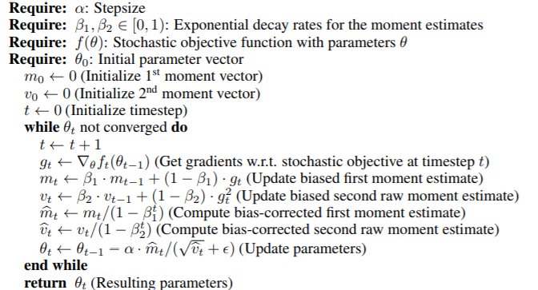
The Adam Algorithm
Updated as below

Slide 29
The Adam Algorithm

Slide 30
Learning and Intro to Neural Nets
Softmax in Output
Optimizers 2/2
Deep Learning
Convolution, Pooling, and Auto-encoding
Summary and Conclusion

Slide 31
Historically:Increasing # Levels Hardly Helped
Until …
Notes:
Since neural nets seemed to show promise, it was believed a long time ago that increasing the number of levels (two in this figure) would make them increasingly useful. But this yielded few new results until the first decades of the 20th century.

Slide 32
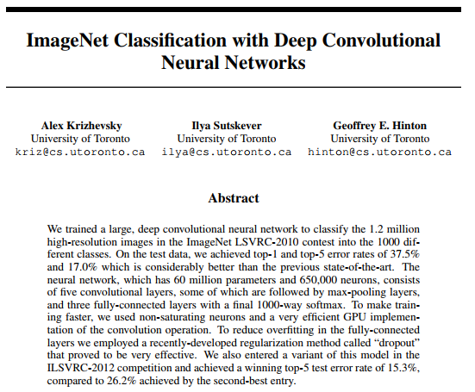
The Classic Paper
(Also see LeCun)
Notes:
This changed with the publication of the classic paper in 2012 by Krishevsky et al.

Slide 33
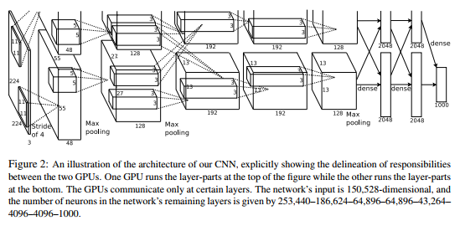
Architecture
Notes:
What brought about the dramatic improvement, and the use of hidden layers are suggested by the figure (from the paper).

Slide 34
Whole Architecture (Parts to Follow)
Notes:
What brought about the dramatic improvement, and the use of particular kinds of hidden layers, as suggested by the figure (from the paper).

Slide 35
Architecture: Input End
Convolution (sliding window—more later)
Notes:
What brought about the dramatic improvement, and the use of hidden layers are suggested by the figure (from the paper): specific architectures for the hidden layers.

Slide 36
Architecture: Output End
Note dense at end.
Pooling (collapsing—more later)
Notes:
What brought about the dramatic improvement, and the use of hidden layers are suggested by the figure (from the paper).

Slide 37
Reasons for Success of Deep Learning
Purpose for each hidden layer
For images: convolution
Availability of massive amounts of varied data
Use of GPU’s
Notes:
The figure lists what are widely believed to be the reasons that deep learning has finally become successful. Convolution is a way of rationally summarizing visual data with acceptable loss. It was also discovered that some processes which seemed to be going nowhere did, in fact, start to converge much later than originally thought.

Slide 38
Learning and Intro to Neural Nets
Softmax in Output
Minimization Techniques
Optimizers 2/2
Convolution, Pooling, and Auto-encoding
Summary and Conclusion
Softmax in Output
Optimizers 2/2
Deep Learning
Convolution, Pooling, and Auto-encoding
Conclusion
Notes:
In this section we discuss the factors that have made deep learning successful.

Slide 39
Image Processing Introduction
…
0
1
1
0
0
…
Notes:
Encoding like that shown in the figure can work—because training and execution work from the same encoding—but this encoding compromises proximity information.

Slide 40
Without Convolution
Notes:
The figure shows image input processing where the proximity information of input points is compromised.

Slide 41
With Convolution
Notes:
With convolution, proximity information of input points is retained.
But convolution is a more general concept, where connectivity is reduced.

Slide 42
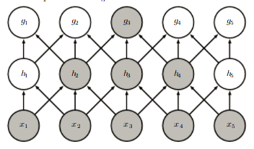
Depth Allows Eventual Integration
From “Deep Learning” by Goodfellow et al http://www.deeplearningbook.org/contents/convnets.html
Notes:
As the figure shows, lateral relationships can be somewhat captured even without full connectivity—by increasing the depth (i.e., by introducing enough layers).

Slide 43
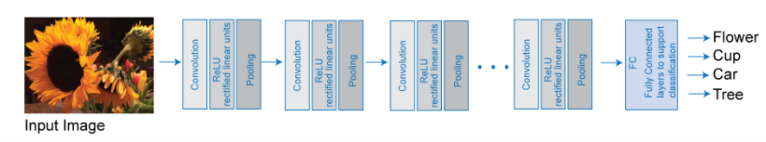
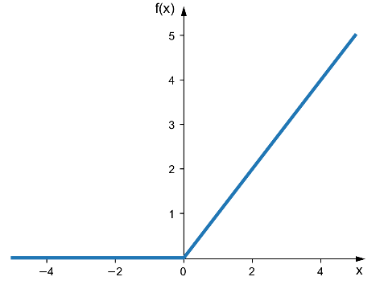
A Convolution Variation (Whole)
ReLU
https://www.mathworks.com/help/nnet/ug/introduction-to-convolutional-neural-networks.html?s_tid=gn_loc_drop
Notes:
Convolution for image recognition is a process of replacing pixel-by-pixel input with sub-region input, typically in a cascading form as shown, where the learning becomes increasingly generalized (e.g., “diagonal bright streak” → “petal form”). The idea of convolution is to preserve the 2D proximity of input, and thus give the neural net more of a start.
After a convolution, more conventional means or additional convolution are used.
Image processing is not the only context in which proximity of input nodes matters: convolution is applicable for a wider set of applications.

Slide 44
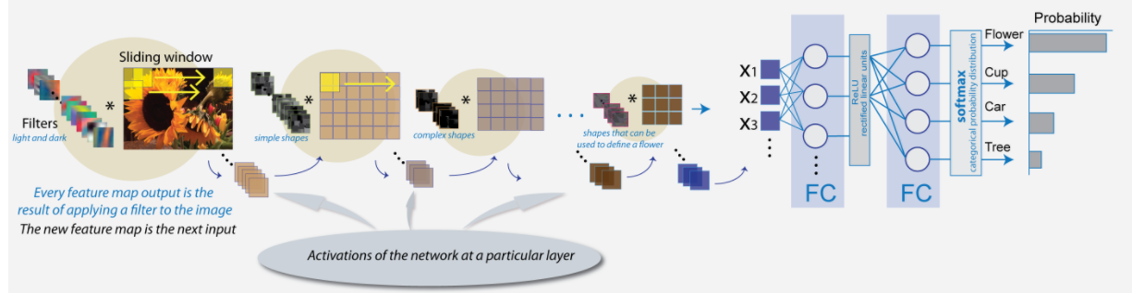
CNN Deep Learning: Input End
https://www.mathworks.com/help/nnet/ug/introduction-to-convolutional-neural-networks.html?s_tid=gn_loc_drop
Notes:
This figure shows multiple convolutions.

Slide 45
CNN Deep Learning: Output End
https://www.mathworks.com/help/nnet/ug/introduction-to-convolutional-neural-networks.html?s_tid=gn_loc_drop
Notes:
This figure shows the last part of a deep net, which is typically conventional.

Slide 46
Pooling
After obtaining convolved features, decide size of region, say m×n, to pool convolved features over.
Divide convolved features into disjoint m × n regions, take mean (or maximum) feature activation over these regions to obtain pooled convolved features.
Adapted from http://ufldl.stanford.edu/tutorial/supervised/Pooling/
Notes:
In some hidden layers, following convolution, one may employ pooling, in which the activation (transfer function) takes averages—or some other summarizing number. This reduces training time, often without too much compromise.

Slide 47
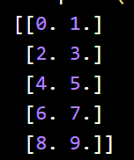
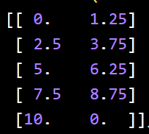
Dropout
A dropout layer fixes random weights as zero, effectively removing neurons. This has the effect of slimming down a level, and reducing overfitting.
The example here* shows
input/output to a layer as follows:
With dropout, it becomes the following.
Note that the output sum is invariant.
Finding an appropriate degree of dropout
is an empirical process.
* https://keras.io/api/layers/regularization_layers/dropout/
Notes:
In some hidden layers, following convolution, one may employ pooling, in which the activation (transfer function) takes averages—or some other summarizing number. This reduces training time, often without too much compromise.

Slide 48
Running MNIST with Adam
'''Train a simple deep CNN on the CIFAR10 small images dataset. It gets to 75% validation accuracy in 25 epochs, and 79% after 50 epochs. ..''' … batch_size = 32 num_classes = 10 epochs = 100 data_augmentation = True * num_predictions = 20 save_dir = os.path.join(os.getcwd(), 'saved_models') …
* “increase amount of data …by cropping, padding, flipping, etc.”
https://towardsdatascience.com/exploring-image-data-augmentation-with-keras-and-tensorflow-a8162d89b844
Based on https://colab.research.google.com/github/tensorflow/tpu/blob/master/tools/colab/fashion_mnist.ipynb Converted to TF 2 by Gagan Kaushal +

Slide 49
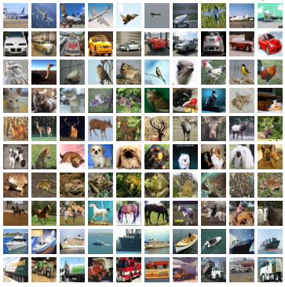
2
# The data, split between train and test sets: (x_train, y_train), (x_test, y_test) = tf.keras.datasets.cifar10.load_data() * …
# Convert class vectors to binary class matrices. y_train = tf.keras.utils.to_categorical(y_train, num_classes) y_test = tf.keras.utils.to_categorical(y_test, num_classes) *
# * see next
*CIFAR-10 dataset = 60000 32x32 color images
in 10 classes, with 6000 images per class…
50000 training, 10000 test

Slide 50
3
import tensorflow as tf import numpy as np labels = np.array([0, 2, 1, 2, 0]) print(labels) labels = tf.keras.utils.to_categorical(labels, 5) print(labels)
[0 2 1 2 0]
[[1. 0. 0. 0. 0.]
[0. 0. 1. 0. 0.]
[0. 1. 0. 0. 0.]
[0. 0. 1. 0. 0.]
[1. 0. 0. 0. 0.]]

Slide 51
keras.layers.Conv2D(
filters,
kernel_size,
strides=(1, 1),
padding='valid',
data_format=None, dilation_rate=(1, 1), activation=None, use_bias=True, kernel_initializer='glorot_uniform', bias_initializer='zeros', kernel_regularizer=None, bias_regularizer=None, activity_regularizer=None, kernel_constraint=None, bias_constraint=None)
dimensionality of output space
height and width of 2D convolution window.
https://keras.io/layers/convolutional/

Slide 52
Defining the Model
4
model = tf.keras.models.Sequential() model.add(tf.keras.layers.Conv2D(32, (3, 3), padding='same', input_shape=x_train.shape[1:])) model.add(tf.keras.layers.Activation('relu')) model.add(tf.keras.layers.Conv2D(32, (3, 3))) model.add(tf.keras.layers.Activation('relu')) model.add(tf.keras.layers.MaxPooling2D(pool_size=(2, 2))) model.add(tf.keras.layers.Dropout(0.25)) model.add(tf.keras.layers.Conv2D(64, (3, 3), padding='same')) model.add(tf.keras.layers.Activation('relu')) model.add(tf.keras.layers.Conv2D(64, (3, 3))) model.add(tf.keras.layers.Activation('relu')) model.add(tf.keras.layers.MaxPooling2D(pool_size=(2, 2))) model.add(tf.keras.layers.Dropout(0.25)) model.add(tf.keras.layers.Flatten()) model.add(tf.keras.layers.Dense(512)) model.add(tf.keras.layers.Activation('relu')) model.add(tf.keras.layers.Dropout(0.5)) model.add(tf.keras.layers.Dense(num_classes)) model.add(tf.keras.layers.Activation('softmax'))
Similar: https://colab.research.google.com/github/tensorflow/tpu/blob/master/tools/colab/fashion_mnist.ipynb

Slide 53
RMSProp
RMSprop(learning_rate=0.001, rho=0.9)
Recommended to leave parameters at default values except the learning rate
Divides the gradient by a running average of its recent magnitude
https://keras.io/optimizers/

Slide 54
Compiling the Model
5
# initiate RMSprop optimizer opt = tf.keras.optimizers.RMSprop(learning_rate=0.0001, decay=1e-6) # Let's train the model using RMSprop model.compile(loss='categorical_crossentropy', optimizer=opt, metrics=['accuracy']) x_train = x_train.astype('float32') x_test = x_test.astype('float32') x_train /= 255 x_test /= 255

Slide 55
Training
7
if not data_augmentation: print('Not using data augmentation.') model.fit(x_train, y_train, batch_size=batch_size, epochs=epochs, validation_data=(x_test, y_test), shuffle=True)

Slide 56
Saving Trained Model
8
# Save model and weights … model_path = os.path.join(save_dir, model_name) model.save(model_path) print('Saved trained model at %s ' % model_path) # Score trained model. scores = model.evaluate(x_test, y_test, verbose=1) print('Test loss:', scores[0]) print('Test accuracy:', scores[1])

Slide 57
… Result …
…
accuracy: 0.7116
710/1563 [============>.................] - ETA: 1:59 - loss: 0.8420 - accuracy: 0.7116
711/1563 [============>.................] - ETA: 1:59 - loss: 0.8416 - accuracy: 0.7118
712/1563 [============>.................] - ETA: 1:58 - loss: 0.8423 - accuracy: 0.7117
713/1563 [============>.................] - ETA: 1:58 - loss: 0.8423 - accuracy: 0.7116
714/1563 [============>.................] - ETA: 1:58 - loss: 0.8426 - accuracy: 0.7115
…

Slide 58
AutoEncoders
a
b
c
“Learning” is a kind of compression.
a
b
c
Notes:
An issue in adding layers is to ensure that they do indeed learn something. “Learning” is a kind of compression. For example, we can learn from multiple statements like “Douglas is a dog”, “David is a dog”, “Caitlin is a cat”, “Dillon is a dog” etc. This compresses multiple statements into “Animals with D-names around here are probably dogs.”
A single layer with dimension reduction obviously learns but it is not obvious that additional layers learn more. One clever way to ensure compression (learning) is by means of encoders. The output to an encoder is the same as its input. This is in effect a separate neural net trained to compress the input data. Once it has learned, only the lower half is used, and the weights are kept constant.

Slide 59
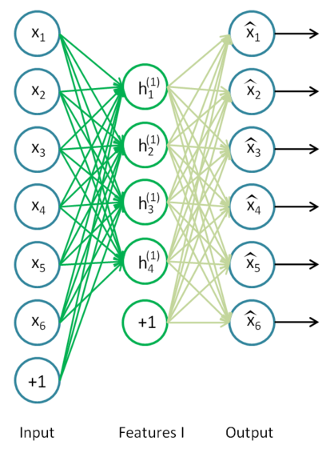
Using AutoEncoders to Perform Deep Learning 1
Classifiers
http://ufldl.stanford.edu/wiki/index.php/Stacked_Autoencoders
Notes:
This example from Stanford used an auto-encoder with bias. Compression is from 6 dimensions to 4.

Slide 60
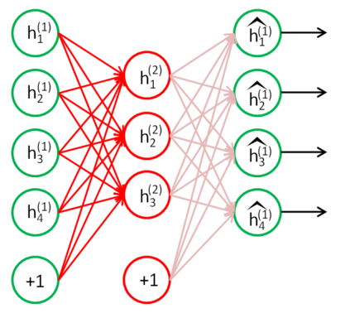
Using AutoEncoders to Perform Deep Learning 2
Classifiers
of classifiers
http://ufldl.stanford.edu/wiki/index.php/Stacked_Autoencoders
Notes:
Auto-encoding is used again in this example to compress from 4 to 3 dimensions.

Slide 61
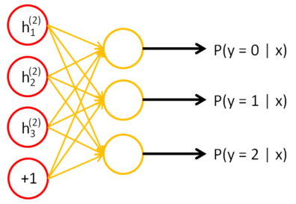
Using AutoEncoders to Perform Deep Learning 3
http://ufldl.stanford.edu/wiki/index.php/Stacked_Autoencoders

Slide 62
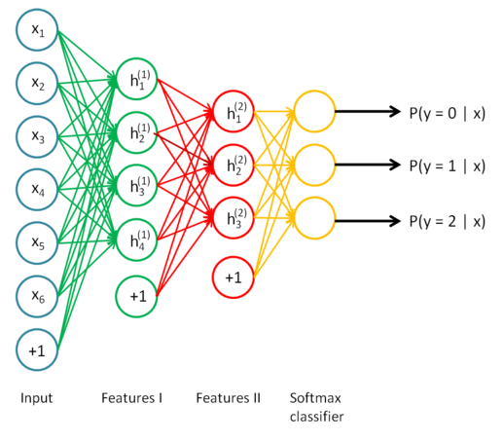
Using AutoEncoders to Perform Deep Learning 4
http://ufldl.stanford.edu/wiki/index.php/Stacked_Autoencoders
Notes:
The two auto-encoders are used in sequence to produce this particular deep learning.
The idea of learning weights in a context taken from the problem at hand, then freezing them and inserting them, is basic to transfer learning.

Slide 63
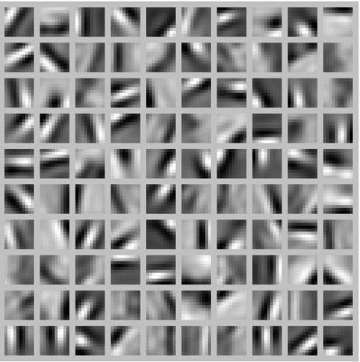
What is Being Learned by These Hidden Nodes?
See “If we have an autoencoder with 100 hidden units (say), then our visualization will have 100 such images—one per hidden unit. …”
at
http://ufldl.stanford.edu/tutorial/unsupervised/Autoencoders/
Notes:
It is sometimes possible to gauge what is being learned by hidden nodes, especially in image processing—in this case recognizing a kind of pattern. Each of these images is reconstructed from the weights of the connections ending at the hidden node in question. So at the next level, a node can be explained as something like 0.1 of image at (x=1, y=1) plus 0.7 of image at (x=2, y=1), etc.

Slide 64
Learning and Intro to Neural Nets
Softmax in Output
Minimization Techniques
Optimizers 2/2
Convolution, Pooling, and Auto-encoding
Summary and Conclusion

Slide 65
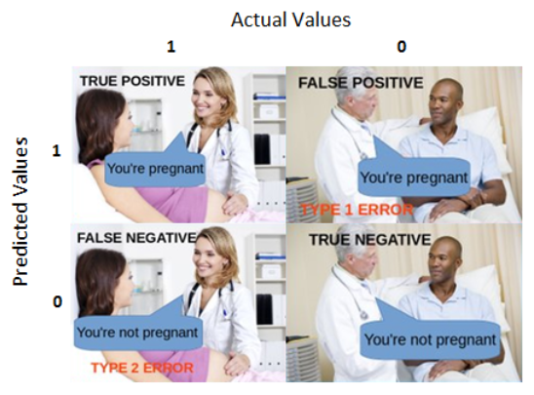
Confusion Matrix
https://towardsdatascience.com/understanding-confusion-matrix-a9ad42dcfd62
Notes:
We typically summarize the performance of a neural net on test data in terms of true positives at one extreme (correct positive predictions) and true negatives at the other (correct negative predictions), and the two incorrect alternatives shown in the figure.

Slide 66
Business Impact of Neural Nets
Recognizes patterns automatically
Handwriting
Voice recognition
…(!)
Applications where math model unobtainable or impractical
Spotting anomalies, faults or variants from the norm
Must have time to learn

Slide 67
TED Talk: Deep Learning Applications
http://www.ted.com/talks/jeremy_howard_the_wonderful_and_terrifying_implications_of_computers_that_can_learn?language=en
Notes:
The URL shows an inspirational talk in the 09’s about machine learning by Jeremy Howard.

Slide 68
Summary
Many architectural options
convolution
pooling
softmax
autoencoders
Many convergence options
Stochastic gradient descent (sgd)
Batch gradient descent
Adam
…

